Slide 1
LOW LATENCY SCHEDULING FOR DELAY SENSITIVE APPLICATIONS
Project Guide : Dr.M.A.Bhagyaveni
Team Members:
Gnanavel K M - 2018105528
Gowtham P - 2018105531
Yokesh N - 2018105623
Aravinth S - 2018105010

Slide 2
OBJECTIVE
The data generated by the IoT devices sent to the cloud for processing the high amount of data.
There is a huge delay due to this, Our idea is to reduce the delay between the IoT devices and cloud services.
So it is very useful in IoT Applications such as healthcare applications, wearables, intelligent transportation systems and smart cities.
Certain delay sensitive applications require low latency , to address this issue we introduce a number of scheduling algorithms.
We compare the benefits of different scheduling algorithms using iFogsim simulator.

Slide 3
INTRODUCTION
In today's world, the internet of things (IoT) is developing rapidly.
Wireless sensor network (WSN) as an infrastructure of loT has limitations in the processing power, storage, and delay for data transfer to cloud.
Also sending all the data generated by the loT to the cloud may not be possible due to limited data carrying capacity of the current network infrastructure.
The integration of IoT with the cloud has some major issues such as latency, bandwidth overuse, real-time response delays, protection, and privacy.
Fog Computing (FC) has been introduced to bring the cloud services closer to the data generating loT devices.

Slide 4
INTRODUCTION (Cont.)
Fog computing is not a replacement for cloud computing, but it reduces the drawbacks of cloud computing, makes it efficient and provides storage and computing services at the edge of the internet.
FC as an extension of cloud to the edge of the network reduces latency and traffic thus, it is very useful in loT applications.
Ifogsim is a standard simulation tool kit for fog computing.
We compare the benefits of different scheduling algorithms using ifogsim simulator.

Slide 5
LITERATURE SURVEY
S.NO | AUTHOR AND JOURNAL NAME | TITLE | CONTENT | INFERENCE
1 | Dadmehr Rahbari, Mohsen Nicray. Turk J Elec Eng & Comp Sci (2019) | Low latency and energy efficient scheduling in fog based IoT Applications | Fog computing Architecture, FCFS and some other algorithms | Fog Computing parameters. Learned about how to calculate Energy Consumption and Total Execution cost
2 | L. F. Bittencourt, J. Diaz-Montes, R. Buyya, O. F. Rana and M. Parashar. IEEE Cloud Computing, 2017. | Mobility –Aware Application Scheduling in Fog Computing | Scheduling in fog computing | Scheduling process in Fog Computing
3 | Gupta H, Dastjerdi AV, Ghosh SK, Buyya R, (2017) | ifogsim - toolkit for modeling and simulation of resource management techniques in internet of things, edge and fog computing environments. | ifogsim software tutorials | It specifies how to handle the different tools of ifogsim.

Slide 6
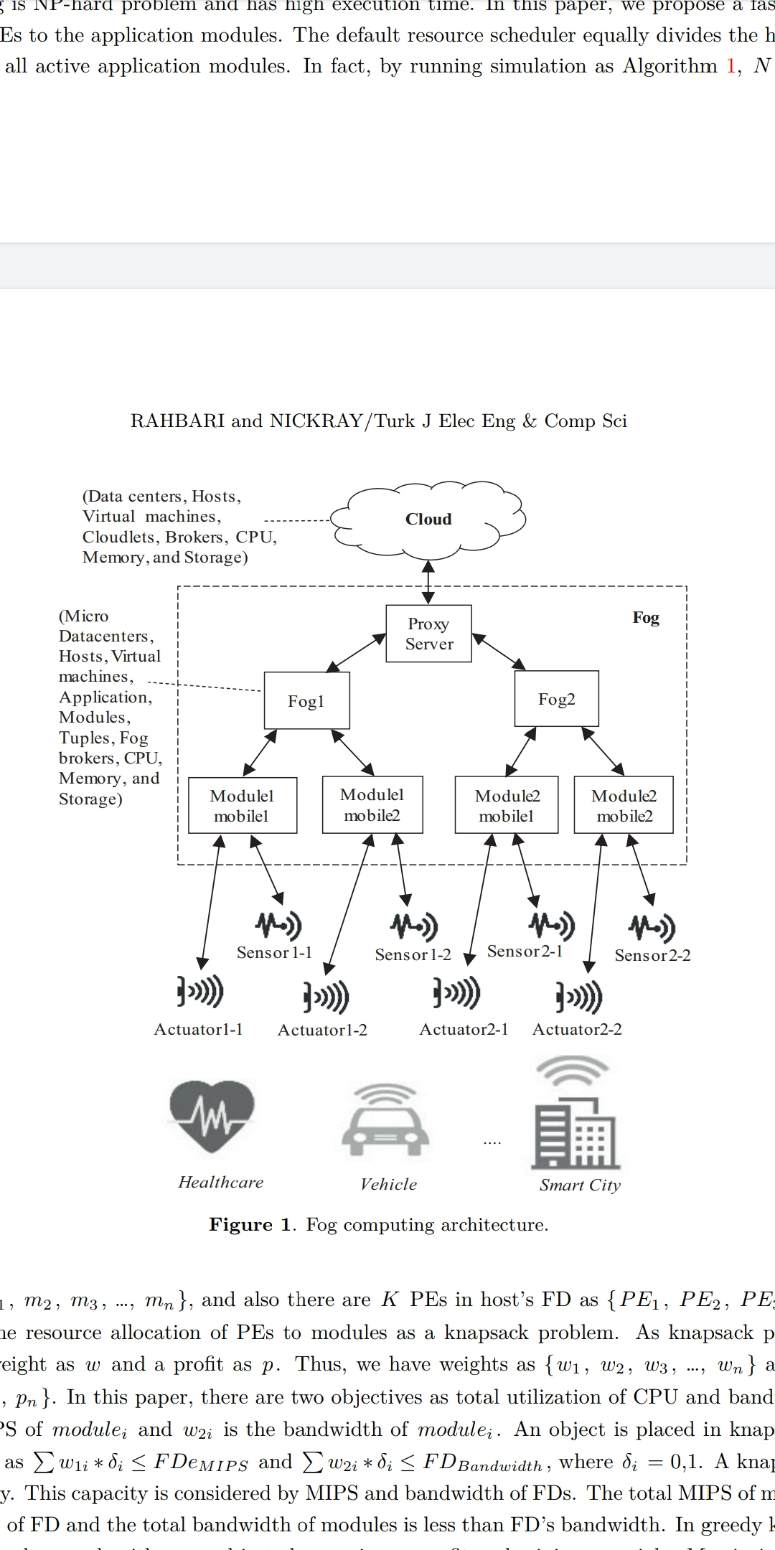
ARCHITECTURE OF FOG COMPUTING

Slide 7
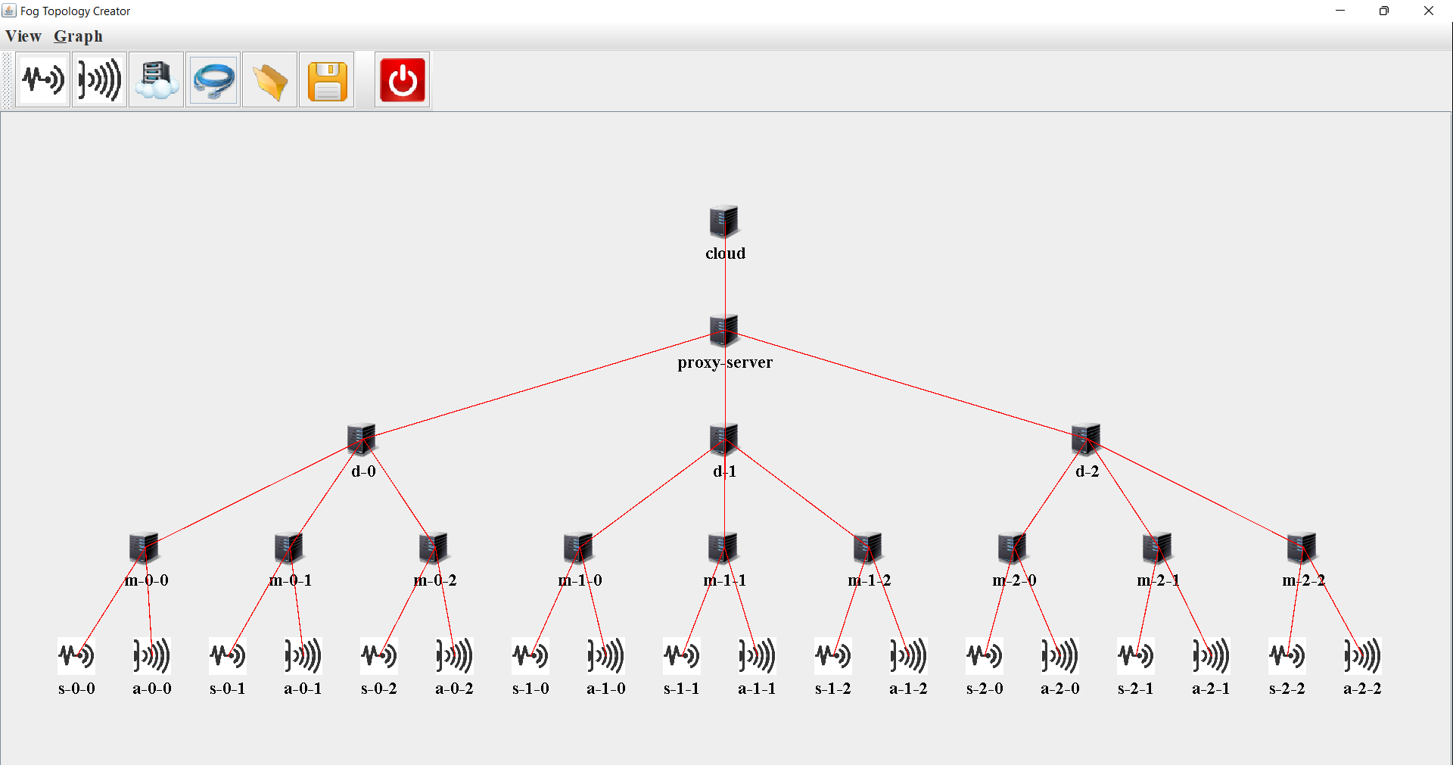
ARCHITECTURE DESIGNED USING GUI

Slide 8
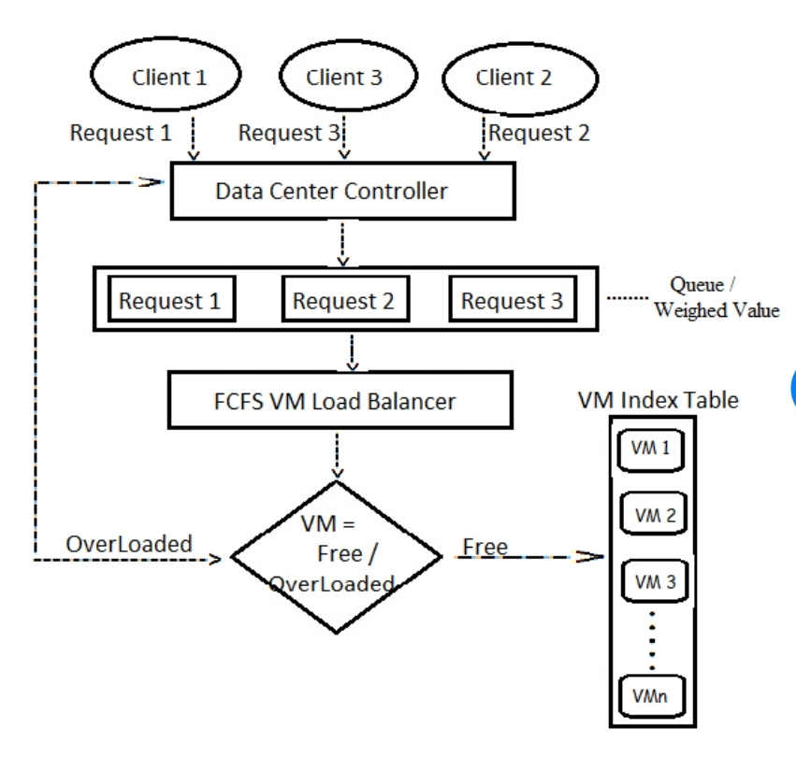
ALGORITHMS USED
FCFS

Slide 9
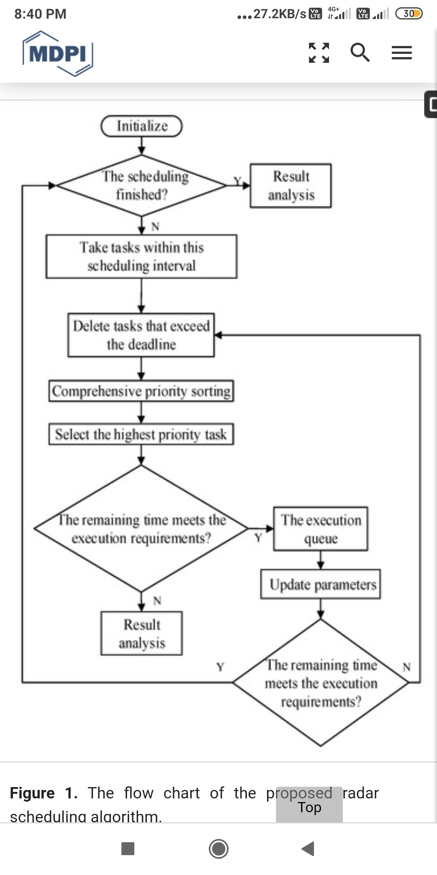
Delay Priority Algorithm

Slide 10
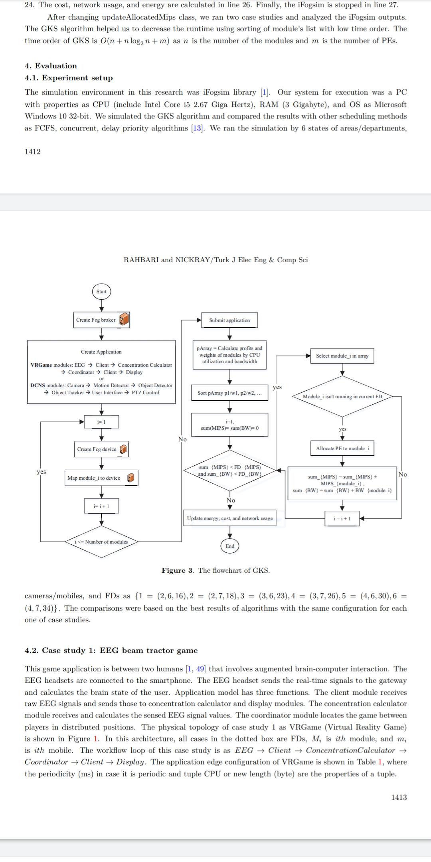
KNAPSACK ALGORITHM

Slide 11
IMPLEMENTATION
Architecture of the total network is designed.
Number of fog devices, sensors, actuators are inserted as per our requirement.
Application is created based on the type of IoT service required, and divided into several modules.
The modules are mapped to the fog devices.
First come First serve algorithm is implemented in the fog level.
Several other algorithms are applied and their performance is compared with each other.
Finally a suitable algorithm will be found that reduces latency and provides delay-free IoT service.

Slide 12
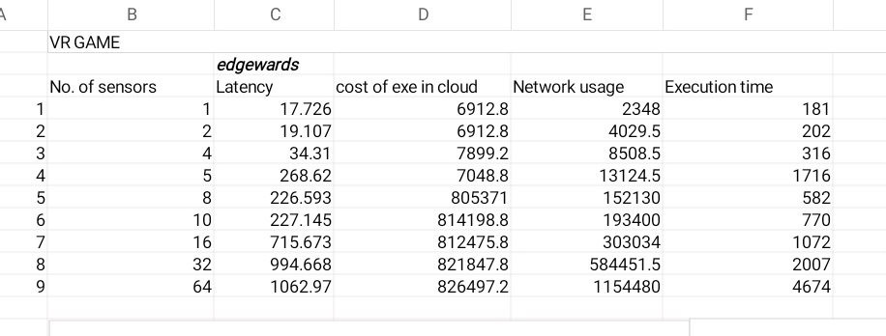
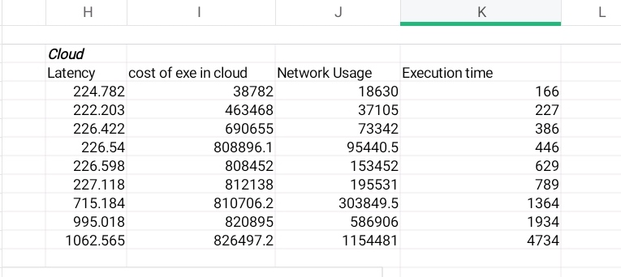
RESULTS

Slide 13
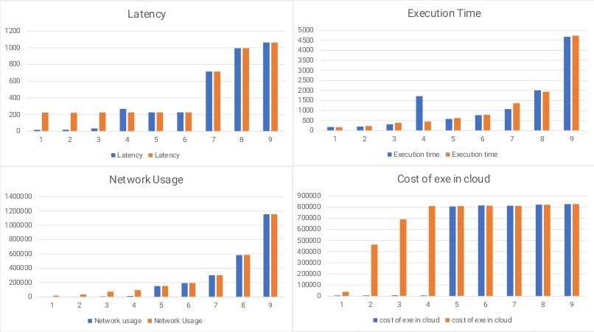
COMPARISON

Slide 14
WORK TO BE DONE
Within Second Review
We will implementing a algorithm other than FCFS in the ifogsim for our specific applications.
Within Third Review
Make use of several algorithms and compare their results to find the suitable algorithm for low latency delay sensitive application.

Slide 15
REFERENCE
L. F. Bittencourt, J. Diaz-Montes, R. Buyya, O. F. Rana and M. Parashar, "Mobility-Aware Application Scheduling in Fog Computing," in IEEE Cloud Computing, vol. 4, no. 2, pp. 26-35, March-April 2017, doi: 10.1109/MCC.2017.27.
J. X. Liao and X. W. Wu, "Resource Allocation and Task Scheduling Scheme in Priority-Based Hierarchical Edge Computing System," 2020 19th International Symposium on Distributed Computing and Applications for Business Engineering and Science (DCABES), 2020, pp. 46-49, doi: 10.1109/DCABES50732.2020.00021.
Gupta H, Dastjerdi AV, Ghosh SK, Buyya R. ifogsim: toolkit for modeling and simulation of resource management techniques in internet of things, edge and fog computing environments. Software: Practice and Experience 2017; 47(9): 1275-1296. doi: 10.1002/spe.2509

Slide 16
THANK YOU
Have a nice day

